Slide 1
Projection Mapping Show control II

Slide 2
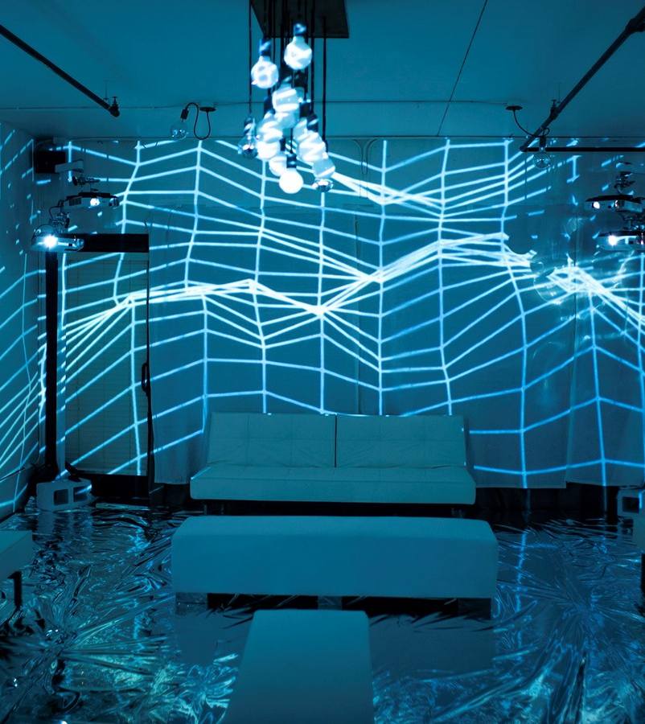
24 October First mini-Expo

Slide 3
No homework here
We only do quick challenges/exercises here
Space to work on your other projects. You can bring your other assignments related to projection mapping and visuals here

Slide 4
Tools

Slide 5
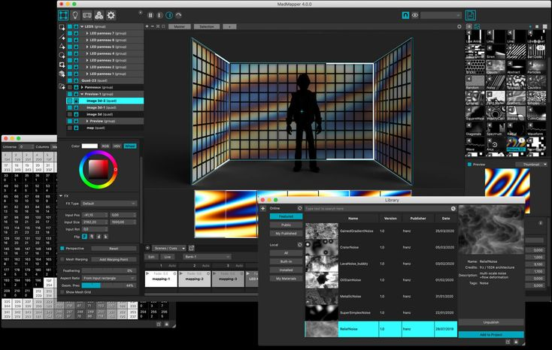



Slide 6
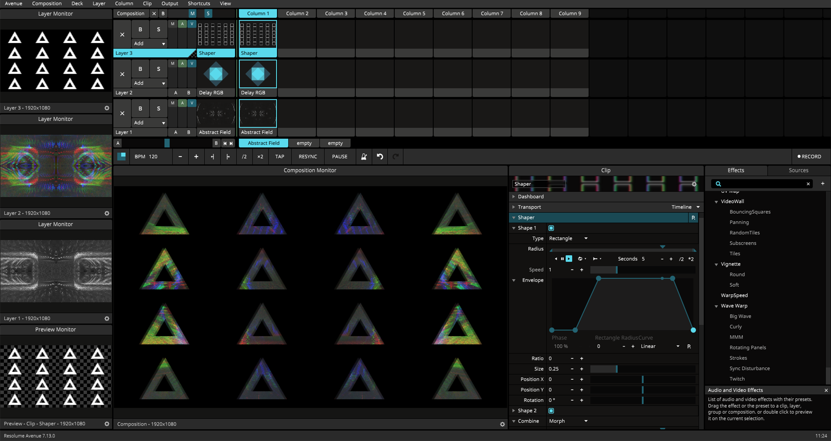


Slide 7
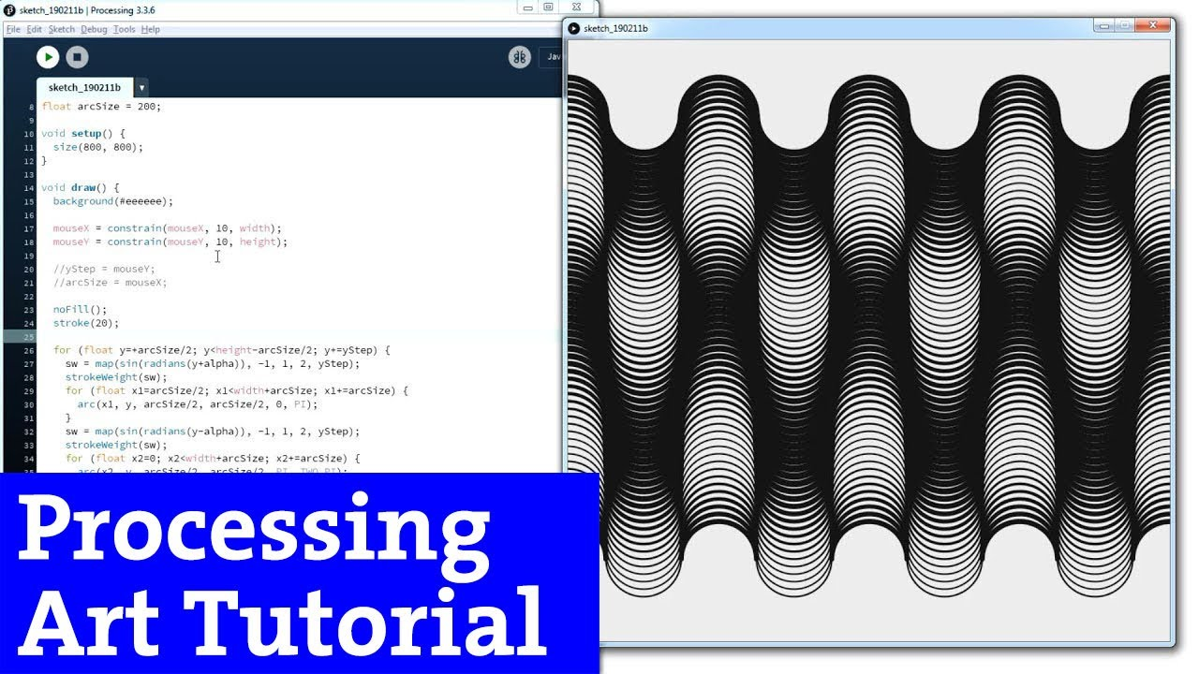

Slide 8
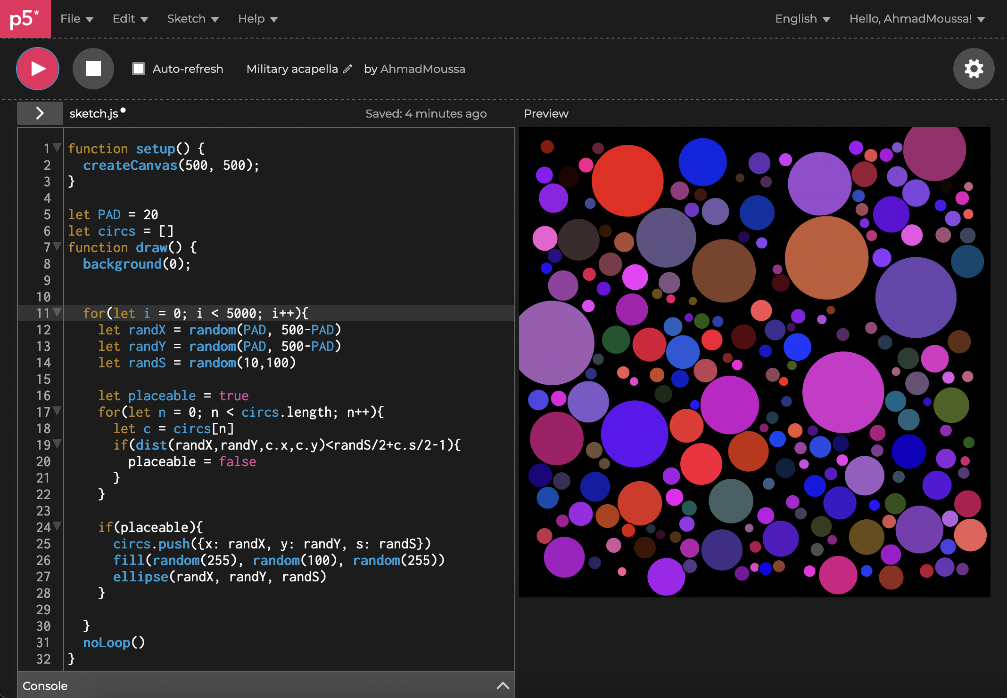


Slide 9
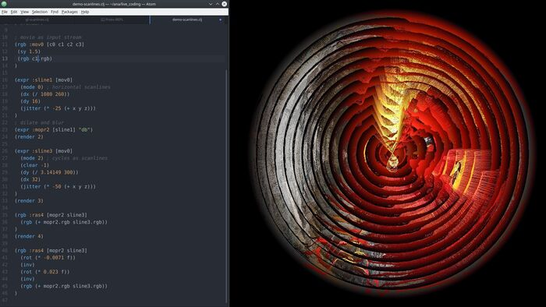


Slide 10
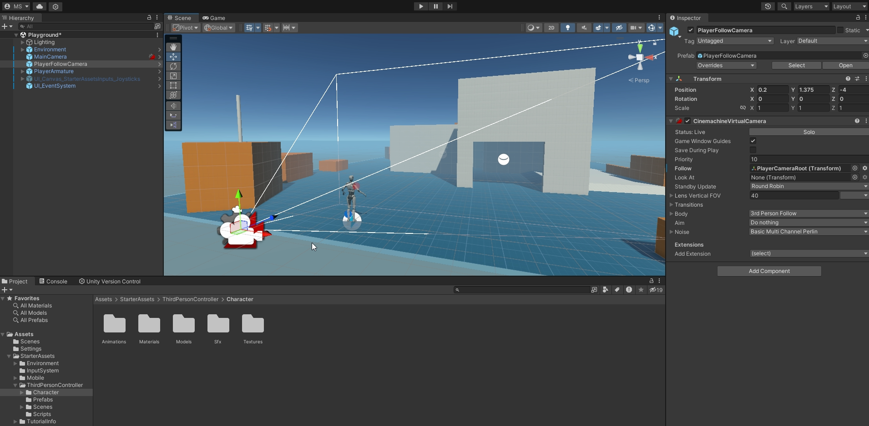


Slide 11
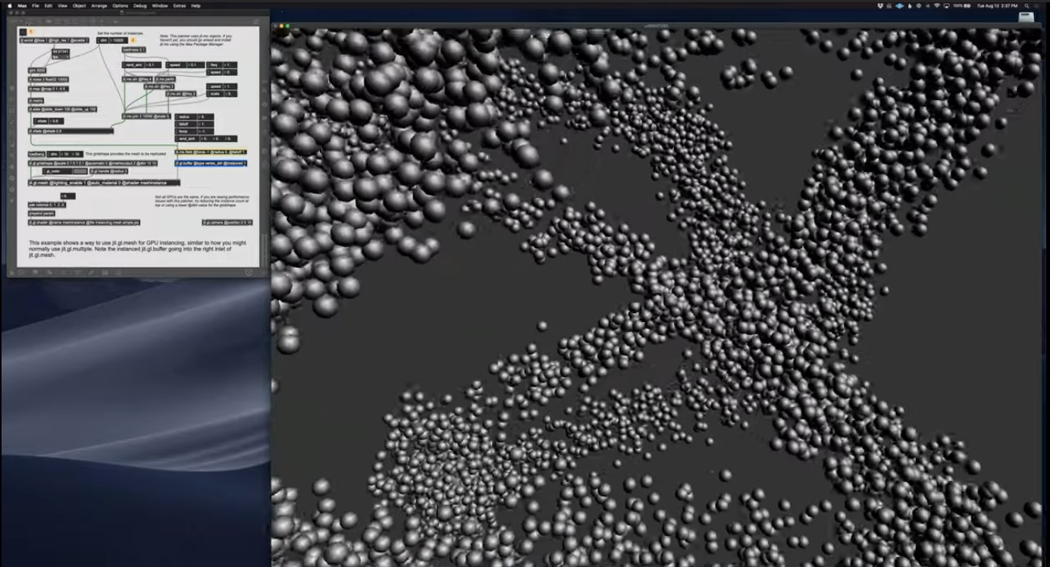
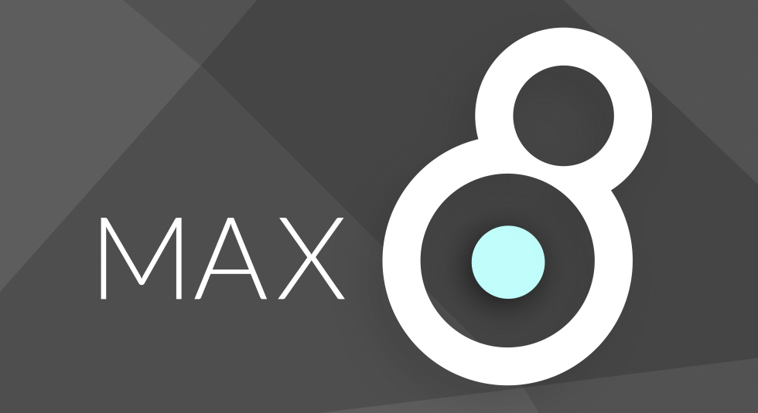

Slide 12
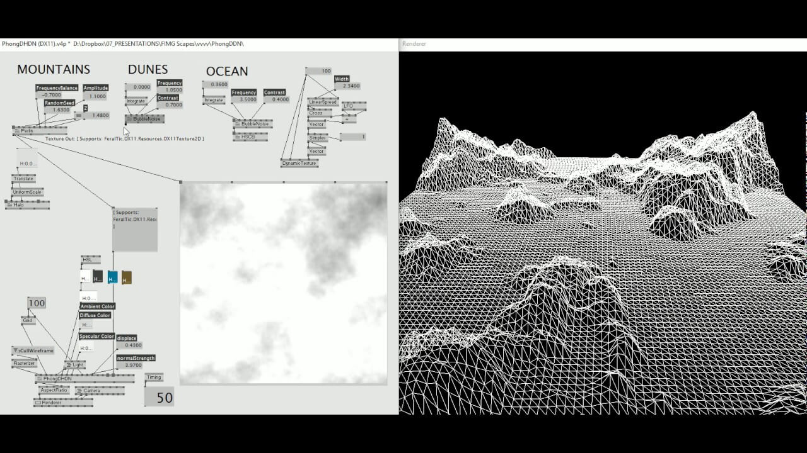


Slide 13
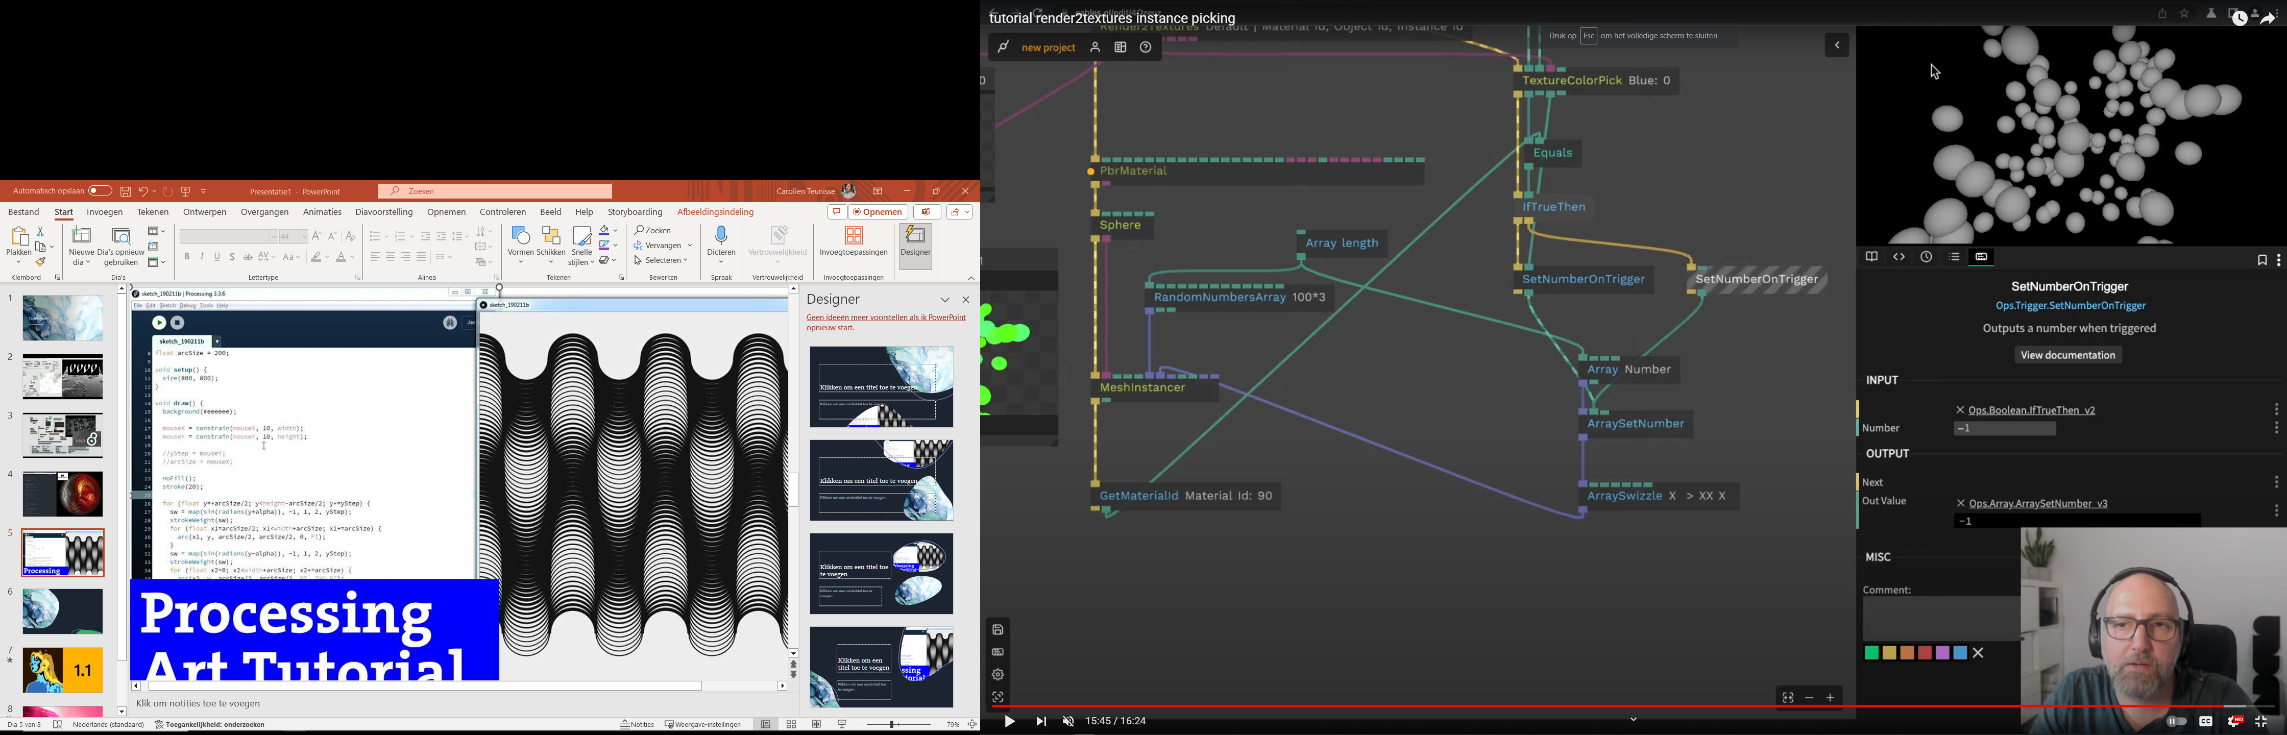


Slide 14
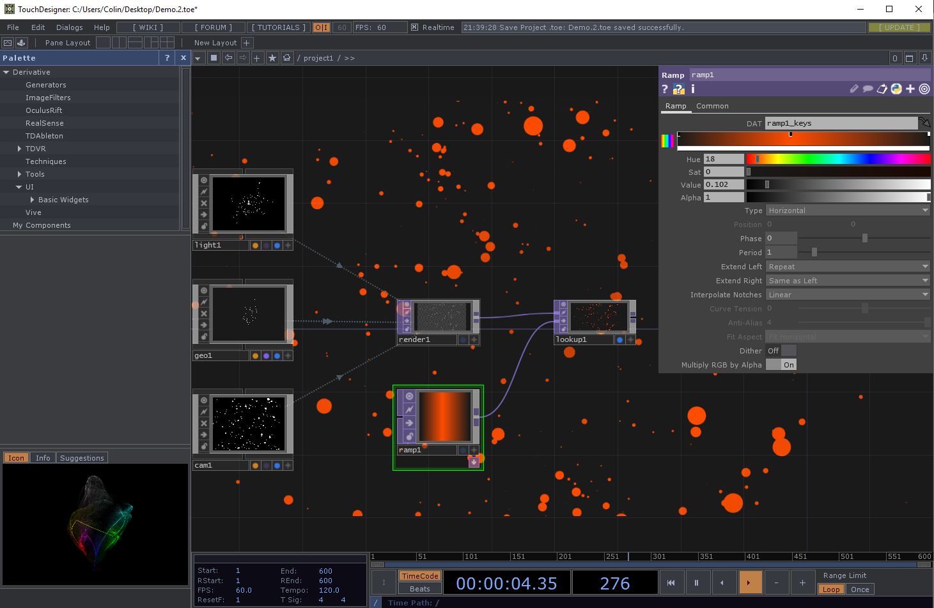

Recommended
by
Raul

Slide 15

Advice: Choose 1 or 2 and take the Pain

Slide 16
Show Control

Slide 17
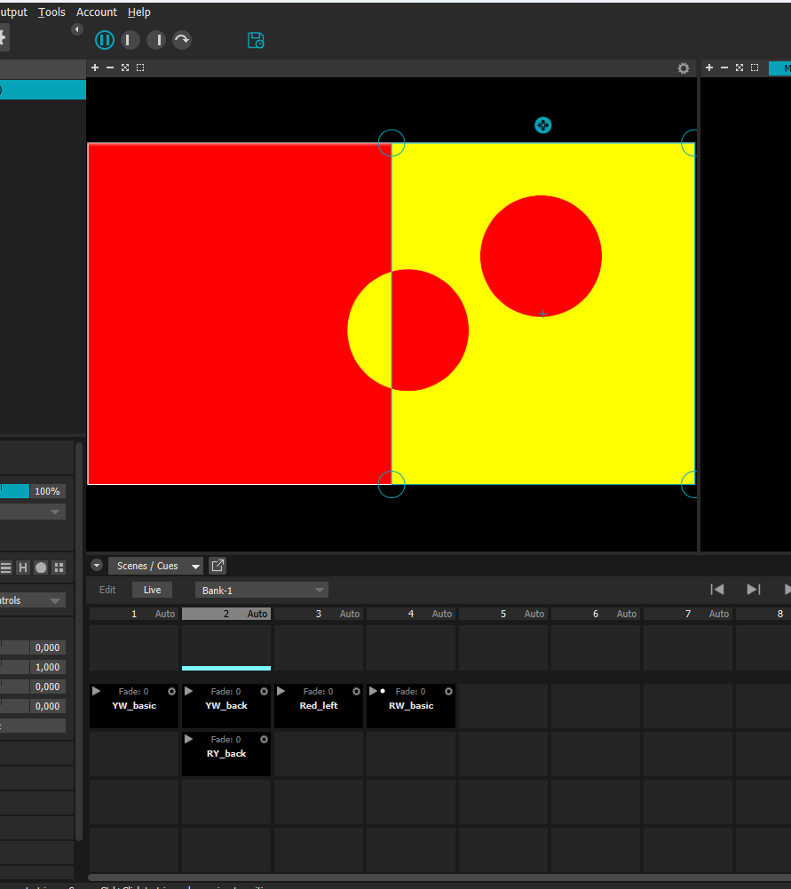
Scenes/Cues
Scenes:
Scenes record all MadMaper parameters on a given moment.
Cues:
Cues record specific parameters.
You can trigger a scene/cue by clicking on it.
You can trigger all cues on a column by clicking on the column

Slide 18
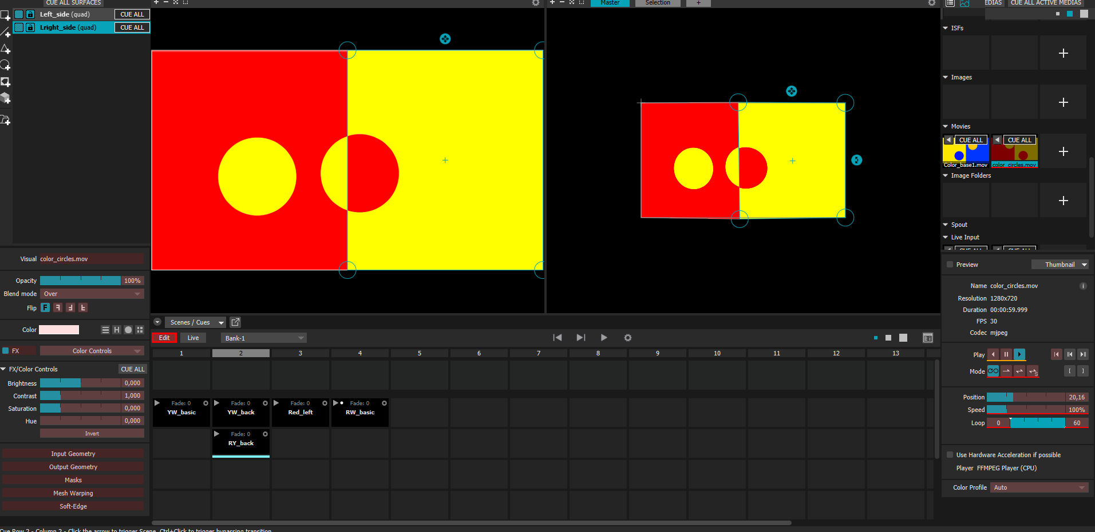
Look back
Edit Button allows you see what parameters are on a scene or cue.

Slide 19
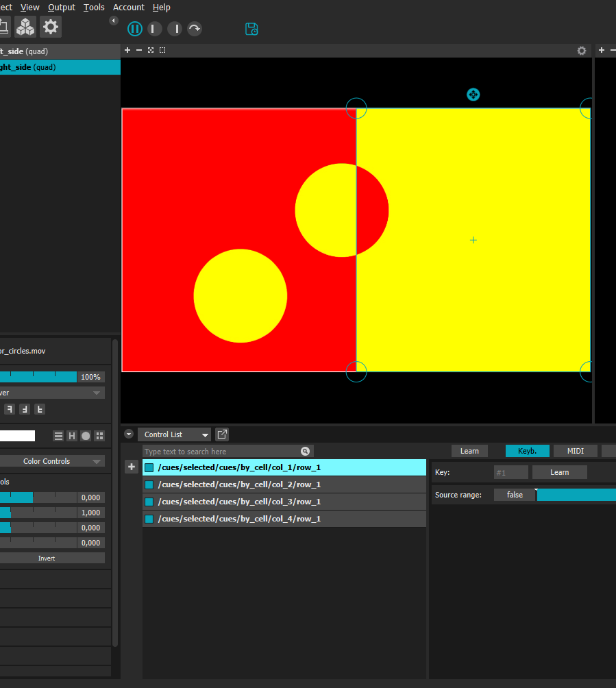
Keyboard
You can link cues and scenes to keyboard keys.
Left click on a scene/cue and then on add control -keyboard

Slide 20
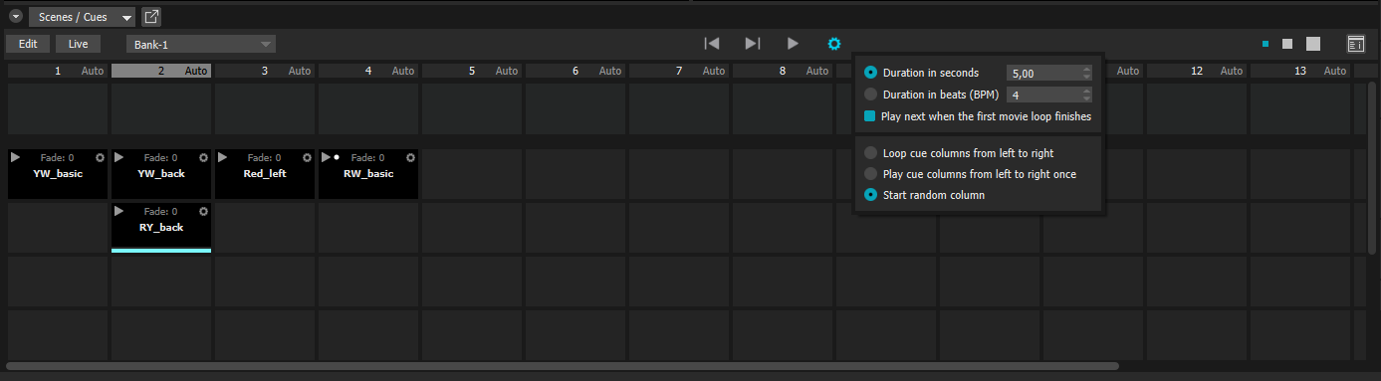
Scheduling
You can play all columns in a sequence by selecting it on the play area.

Slide 21
Challenge

Slide 22
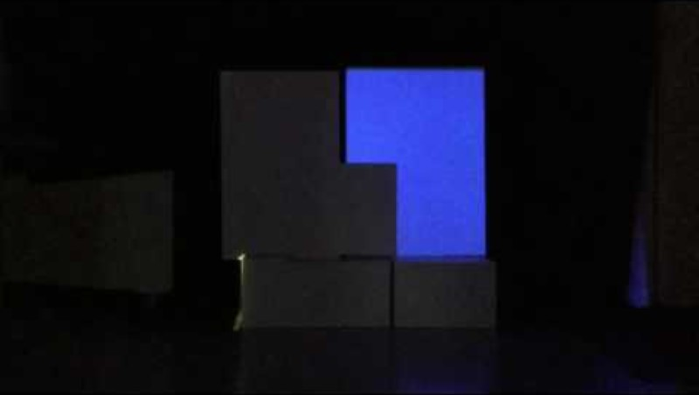

Slide 23
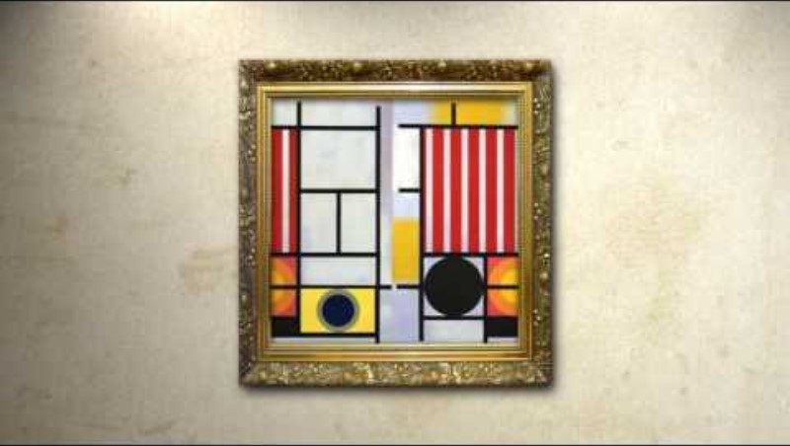

Slide 24
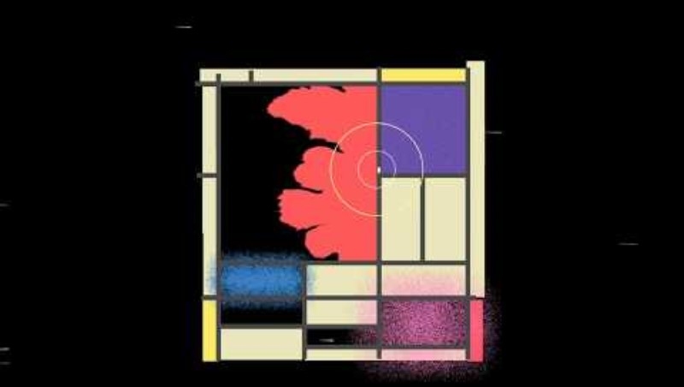

Slide 25


Slide 26
Challenge 2
Make a 2 to 3-minute projection mapping show (Inspired by Mondrian colors)
Use at least four different types of controls that change the projections in the show.
Present on 15:15
Tip: Keep the mapping simple

Slide 27

Thank you

